Slide 1


Nico T
09-11-2022

Slide 2

Outline
Executive Summary
Introduction
Methodology
Results
Conclusion
Appendix

Slide 3
Executive Summary
Summary of methodologies
- Data collection (API, SQL and Webscraping)
- Data Wrangling
- Launchsite Maps & Insights
- Predictive Analysis.
Summary of all results
Data analysis
Optimal model.

Slide 4
Introduction
Project background and context
Space X’s Falcon 9 rocket costs between 62 mln. USD and 165 mln. USD each. Savings can be had by reusing the first stage. If we can determine the success of landing the first stage we can beter estimate launch costs. This information can be used by an alternate company who wants to bid against Space X. The goal is to create a ML pipeline to predict success rates of first stage landings.
Key areas of interest
What factors determine if the rocket will land successfully.
The interaction amongst various features that determine the success rate of a successful landing.
What operating conditions need to be in place to ensure a successful landing program.

Slide 5

Section 1

Slide 6
GitHub
Executive Summary
Data collection methodology:
Via SpaceX Rest API
Webscrapping from Wikipedia
Perform data wrangling
One hot encoding data fields and removing irrelevant columns, data transformation for ML.
Perform exploratory data analysis (EDA) using visualization and SQL
Perform interactive visual analytics using Folium and Plotly Dash
Perform predictive analysis using classification models
How to build, tune, evaluate classification models
Methodology

Slide 7
GitHub
Data collection was done by requesting data from the SpaceX API.
Transform the response into a Json using .json() and inturn normalize into a pandas dataframe
Cleaned the data; replaced missing values for mean values.
Webscraping Wikipedia for Falcon 9 launch history with BeautifulSoup
Extract as HTML table, parse the table and convert to Pandas Dataframe.
Data Collection

Slide 8
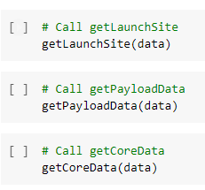
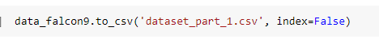
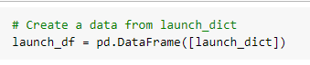
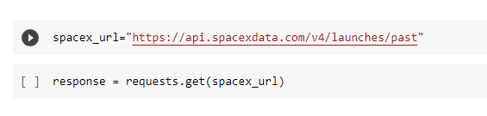
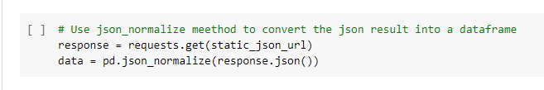
GitHub
Data Collection – SpaceX API
API Response
Response to JSON
Filter dataform to CSV
Clean Data (IBM Functions
List to Dataframe

Slide 9
GitHub
Data Collection - Scraping
Request Flcon9 Data from Wikipedia
Extract column and variable names from the HTML Table Header
Creation of a data frame by parsing the launch HTML Tables

Slide 10
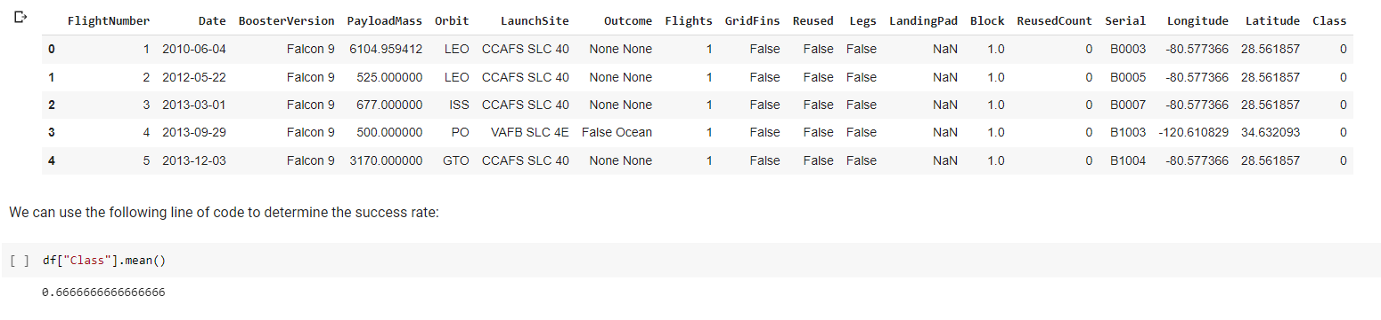
GitHub
Data Wrangling
Task
Task 1
Calculate the number of launches per launch site
Task
Task 2
Calculate the number and occurrence of each orbit
Task
Task 3
Calculate the number and occurence of mission outcome per orbit type
Task
Task 4
Create a landing outcome labal from Outcome Column

Slide 11
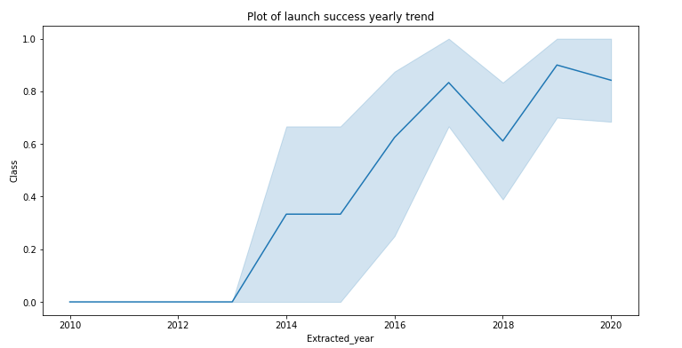
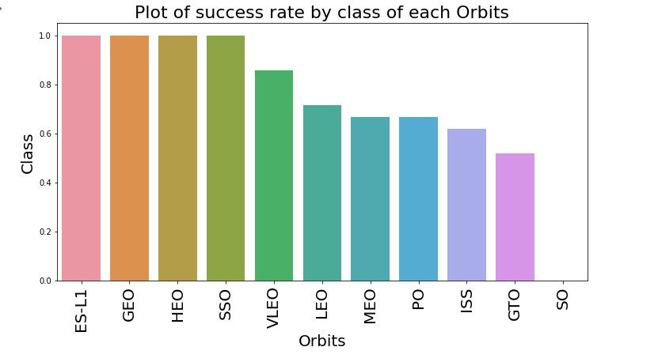
EDA with Data Visualization
GitHub

Slide 12
GitHub
EDA with SQL
SpaceX data loaded into the IBM SQl Database and extract the data using Jupiter notebook.
EDA with SQl to gain insights from the data; queries writing to found out:
Names of unique launch sites
Total payload mass carried
Average payload mass carried
Number of successful and failed mission outcomes
Failure rates via launch site name, drone ship or booster version.

Slide 13
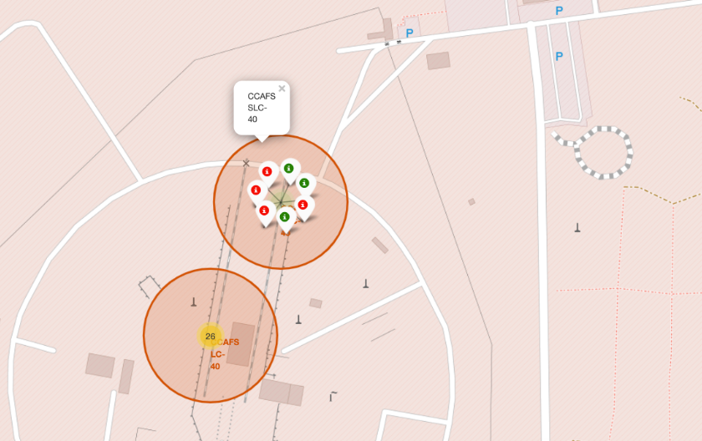

Build an Interactive Map with Folium
GitHub
Mark
Mark launch sites
Mark
Mark success/failed launches per launch site
Calculate
Calculate the distances between a launch site to its proximities

Slide 14
GitHub
Build a Dashboard with Plotly Dash
Interactive Plotly Dashboard
Pie charts showing launches per site
Plotted scatter graph showing relationships between variables

Slide 15
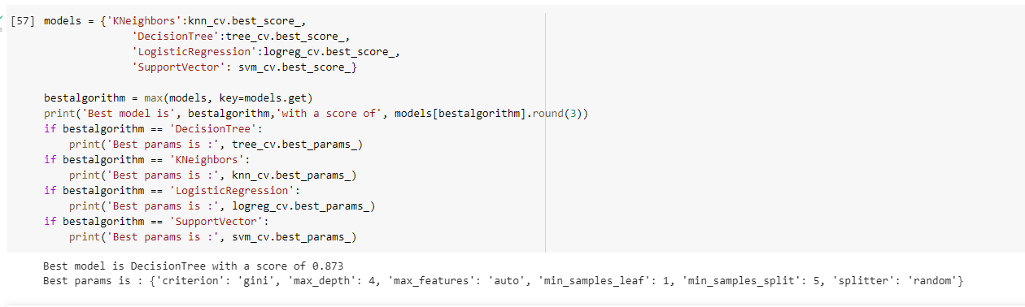
GitHub
Predictive Analysis (Classification)
Perform exploratory Data Analysis and determine Training Labels
create a column for the class
Standardize the data
Split into training data and test data
Find best Hyperparameter for SVM, Classification Trees and Logistic Regression
Find the method performs best using test data

Slide 16

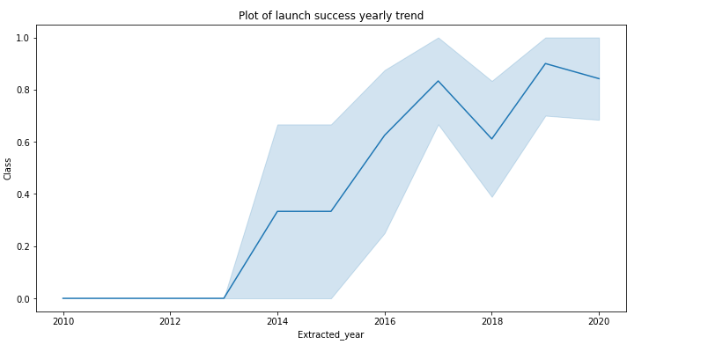
GitHub
Results
Exploratory data analysis results
Interactive analytics demo in screenshots
Predictive analysis results
Best model is a DecisionTree with a score of 0,87

Slide 17

Section 2

Slide 18
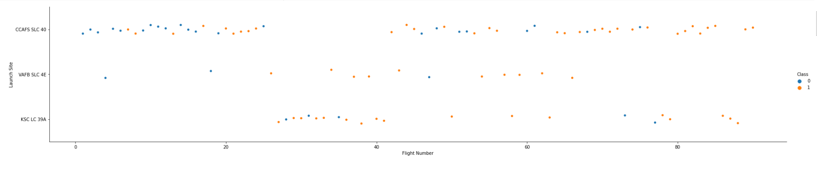
Flight Number vs. Launch Site

Slide 19
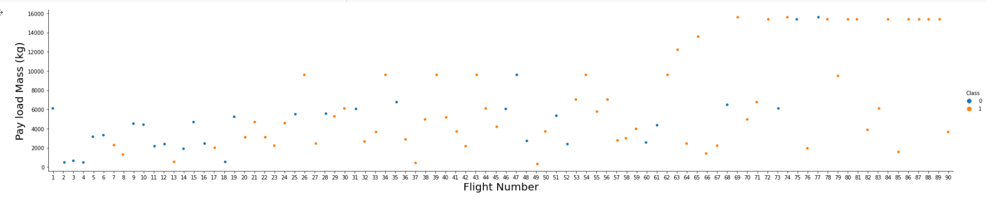
Payload vs. Launch Site

Slide 20
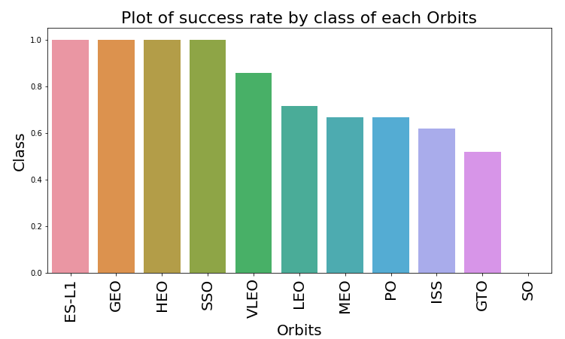
Success Rate vs. Orbit Type

Slide 21
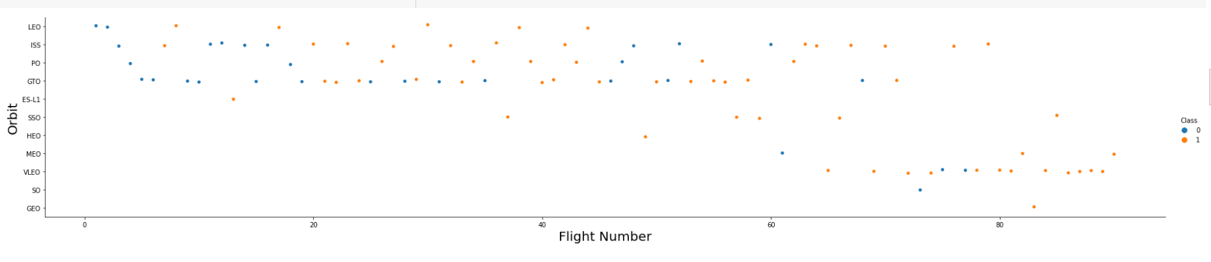
Flight Number vs. Orbit Type

Slide 22
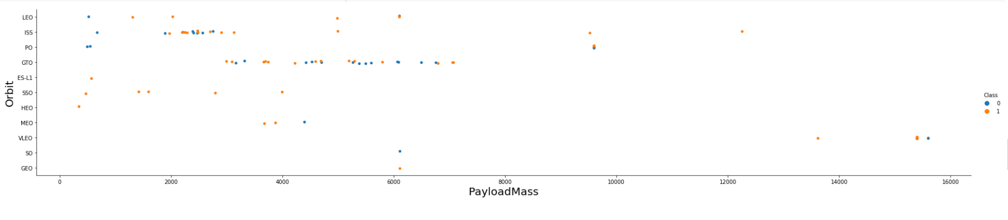
Payload vs. Orbit Type

Slide 23
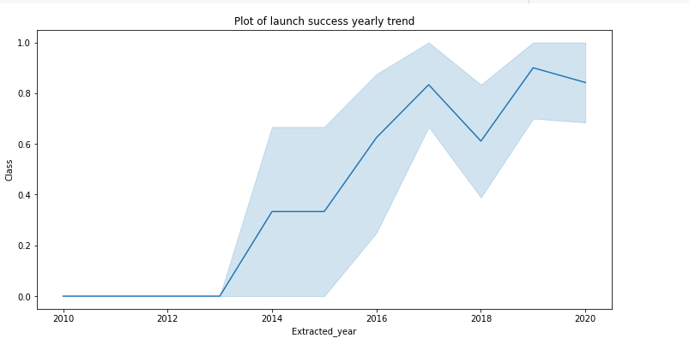
Launch Success Yearly Trend

Slide 24
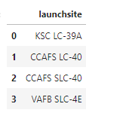
All Launch Site Names
“DISTINCT” is used to show only unique launch sites from the dataset.
%SQL Select Distinct Launch_shite as “Launch_Sites” FROM SPACEX;

Slide 25
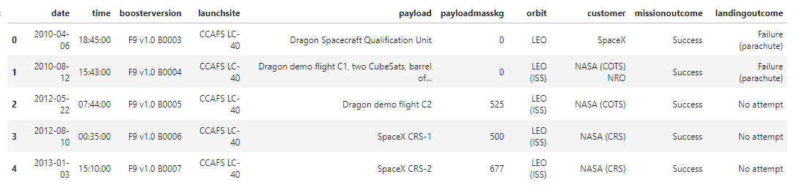
Launch Site Names Begin with 'CCA'
%SQL SELECT * FROM SPACEX WHERE LAUNCH_SITE LIKE ‘CCA%’ LIMIT 5

Slide 26

Total Payload Mass
%SQL SELECT SUM(PAYLOAD_MASS_KG_) AS “Total Payload Mass by NASA (CRS)” FROM SPACEX WHERE CUSTOMER = ‘NASA (CRS)’

Slide 27
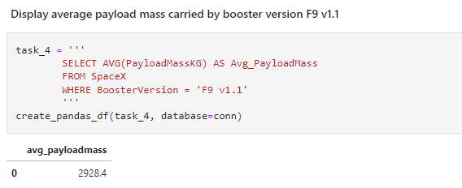
Average Payload Mass by F9 v1.1

Slide 28
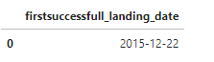
First Successful Ground Landing Date
SELECT MIN(Date) AS FirstSuccessfull_landing_date
FROM SpaceX
WHERE LandingOutcome LIKE 'Success (ground pad)

Slide 29
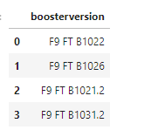
Successful Drone Ship Landing with Payload between 4000 and 6000
SELECT BoosterVersion
FROM SpaceX
WHERE LandingOutcome = 'Success (drone ship)'
AND PayloadMassKG > 4000
AND PayloadMassKG < 6000

Slide 30
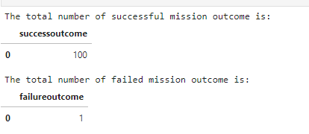
Total Number of Successful and Failure Mission Outcomes
SELECT COUNT(MissionOutcome) AS SuccessOutcome
FROM SpaceX
WHERE MissionOutcome LIKE 'Success%'
SELECT COUNT(MissionOutcome) AS FailureOutcome
FROM SpaceX
WHERE MissionOutcome LIKE 'Failure%'

Slide 31
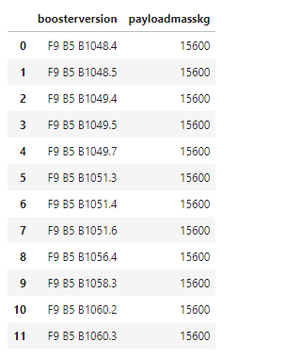
Boosters Carried Maximum Payload
SELECT BoosterVersion, PayloadMassKG
FROM SpaceX
WHERE PayloadMassKG = (
SELECT MAX(PayloadMassKG)
FROM SpaceX
)
ORDER BY BoosterVersion

Slide 32
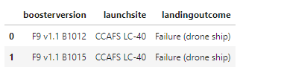
2015 Launch Records
SELECT BoosterVersion, LaunchSite, LandingOutcome
FROM SpaceX
WHERE LandingOutcome LIKE 'Failure (drone ship)'
AND Date BETWEEN '2015-01-01' AND '2015-12-31'

Slide 33
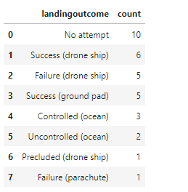
Rank Landing Outcomes Between 2010-06-04 and 2017-03-20
SELECT LandingOutcome, COUNT(LandingOutcome)
FROM SpaceX
WHERE DATE BETWEEN '2010-06-04' AND '2017-03-20'
GROUP BY LandingOutcome
ORDER BY COUNT(LandingOutcome) DESC

Slide 34

Section 3

Slide 35
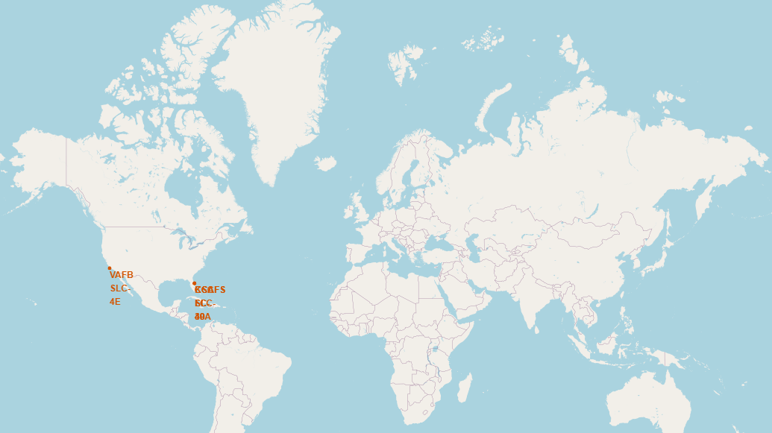
Launch Sites

Slide 36
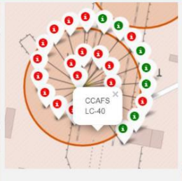
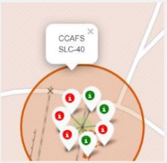
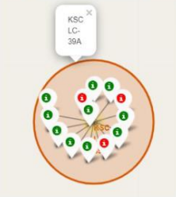
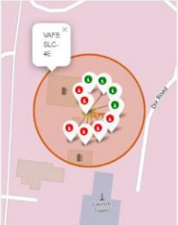
Succes Rates

Slide 37
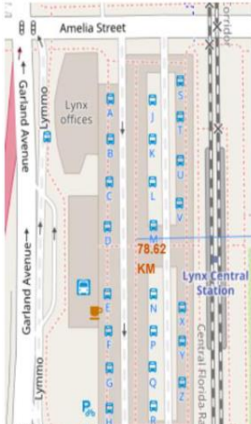
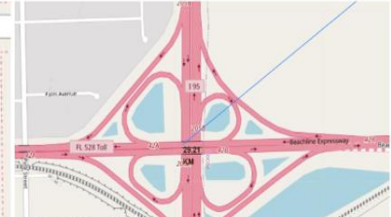
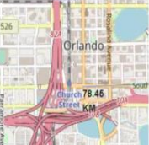
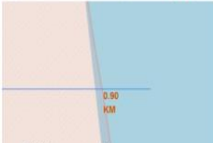
<Folium Map Screenshot 3>
Landmark | Distance
Highway | 29,2 km
Railway Station | 78,6 km
Coastline | 0,9 km
City | 78,46 km

Slide 38

Section 4

Slide 39
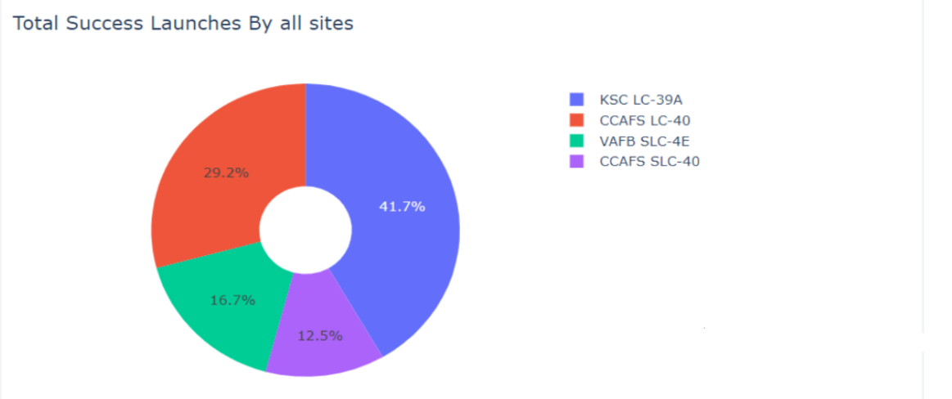
Total Successful launches per site

Slide 40
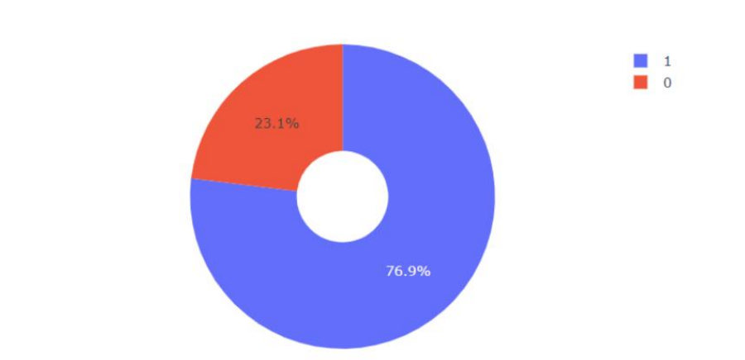
Launch site with highest success ratio
KSC LC-39A achieved a 77% success rate when launching rockets.

Slide 41
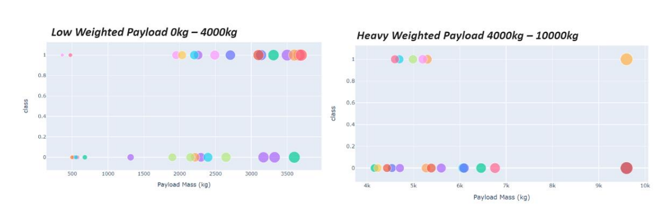
<Dashboard Screenshot 3>
Succes rate for payloads in a low weight class is higher than the heavy weight payloads

Slide 42

Section 5

Slide 43
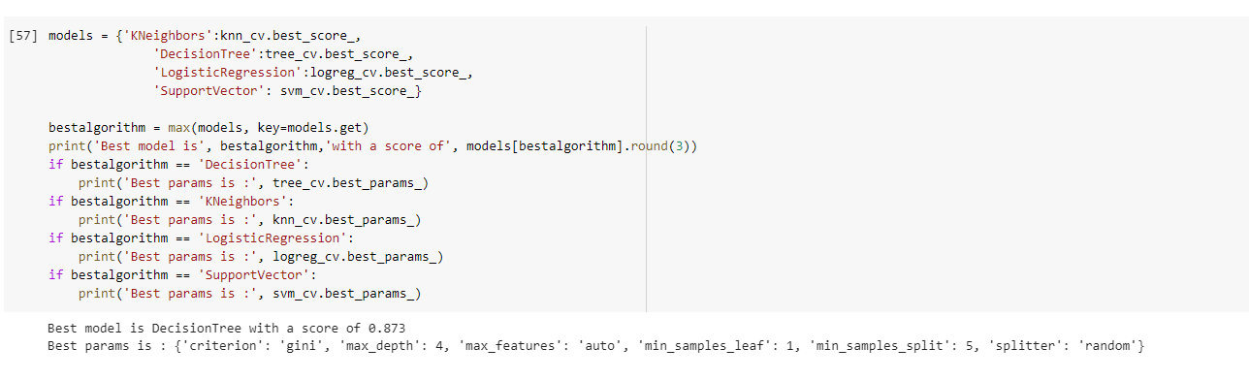
Classification Accuracy

Slide 44
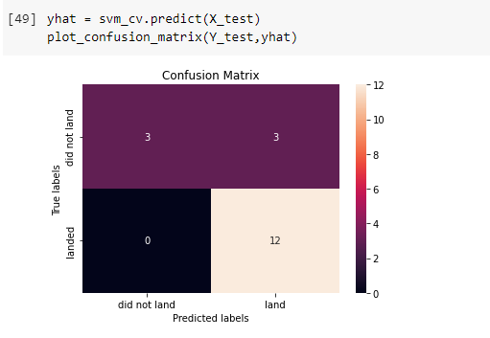
Confusion Matrix
Decision Tree classifier

Slide 45
Conclusions
Results show that:
The more intense a launch site is being used the greater the success rate of launches
Significant increase in success rates over time
KSC LC-39A is the most successful launchsite
Some orbits outperform others (e.g VLEO, GEO, ES-l1 etc.)
Increasing payload mass decreases success chance.
Decision Tree Classifier is the best predictive algorithm for this case.

Slide 46
GitHub
Appendix
See GitHUB

Slide 47


